Slide 1
Practical Lecture: Network Visualization & Understanding
University of Washington
EE 596/AMATH 563
Spring 2021

Slide 2
Outline
Network Visualization
Visualize convolutional layer filters
Visualize feature maps
Network Understanding
Saliency maps
Fooling images
Class visualization
Notes:
Today, we will discuss the network visualization and understanding.
We will start by discussing how to visualize the convolutional layer filters and feature maps in practice.
We will then introduce several examples to understand what exactly are learned in our network such as generating saliency maps and fooling images.

Slide 3
CNN visualization
Notes:
We will start with discussing CNN visualization

Slide 4
Example: Visualizing VGG-16 Model
Load the pre-trained VGG-16 model
Access the convolutional layers and their weights
Visualize convolutional layer filters
Visualize the feature maps
Notes:
In this tutorial, we will use VGG-16 as the base model.
We will first show how to load the pre-trained VGG-16 model using Pytorch

Slide 5
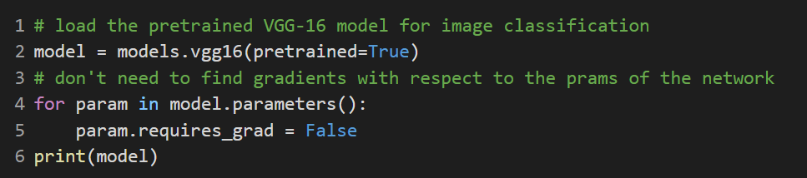
Load the pre-trained VGG-16 Model
We will load the VGG-16 model from torchvision.models module
The torchvision.models module contains a set of definitions of models for addressing different tasks.
Include random/pretrained AlexNet, VGG, ResNet, GoogleNet, etc.
Notes:
The easiest way to obtain the pre-trained VGG-16 model is to use torchvision.models module
The torchvision.models module contains a set of definitions of models for addressing different tasks.
It includes both random and pretrained networks such as AlextNet, VGG, ResNet, GoogleNet and other popular models.
We can simply use one line code to load the pretrained VGG-16 model by setting the pretrained argument be true.
Since we only want to visualize the properties in this pre-trained model and don’t need to find gradients with respect to the parameters of the network, we will set the requires_grad property be false.

Slide 6
Steps of Visualizing CNNs
Load a pre-trained model
Access the convolutional layers and their weights
Visualize convolutional layer filters
Visualize the feature maps
Notes:
Now we will access the convolutional layers and their weights

Slide 7
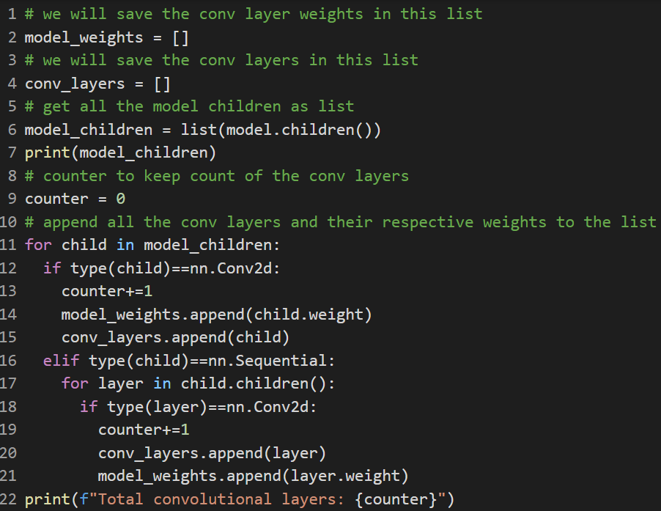
Access the convolutional layers and weights
Get all the model children
model.children()
Find the Conv layers
if type(child) == nn.Conv2d
Access the weights
child.weight
Save the weights in a list
Notes:
We first get all the model children as list using the model.children()
Next we will use a for loop to find the convolutional layers when it satisfies the condition that the type of the child is equal to nn.Conv2d.
Then we can access the weights using child.weight
Finally we will save the convolutional layers and their weights in lists.

Slide 8
Steps of Visualizing CNNs
Load a pre-trained model
Access the convolutional layers and their weights
Visualize convolutional layer filters
Visualize the feature maps
Notes:
Now we are ready to visualize the convolutional layer filters

Slide 9
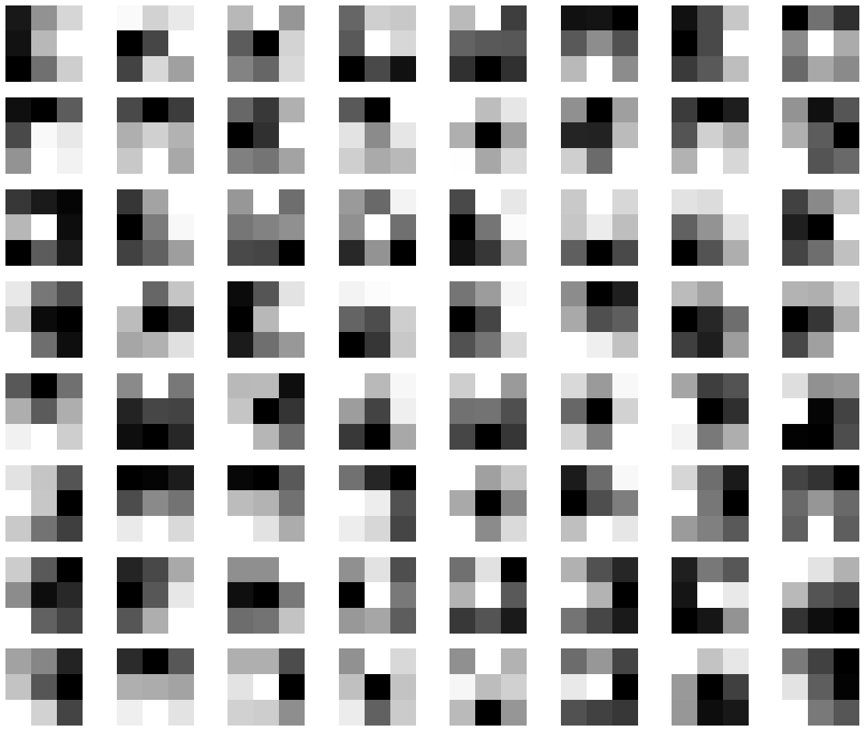
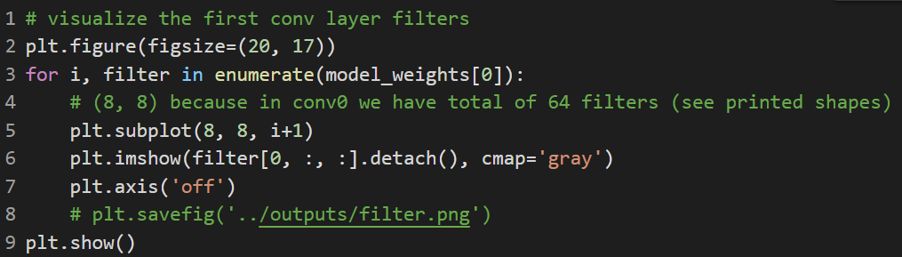
Visualize convolutional layer filters
Example to visualize the first Conv layer filters
The first Conv layer of VGG-16 contains 64 3x3 filters
First Conv Layer Filters shown as images
Notes:
To visualize the conv layer filters, we can simply enumerate the list we have saved and plot out the filters
Remember the first conv layer of VGG-16 contains 64 3x3 filters and here we show them on the right figure.
You are welcome to play with the code and explore the filters in different models and layers

Slide 10
Steps of Visualizing CNNs
Load a pre-trained model
Access the convolutional layers and their weights
Visualize convolutional layer filters
Visualize the feature maps
Notes:
Next, we will visualize the feature maps

Slide 11
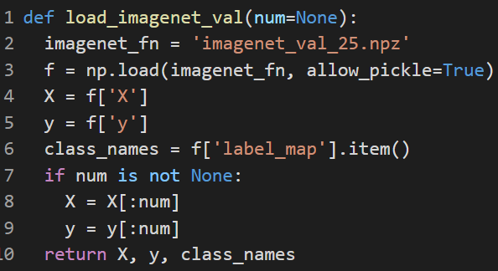
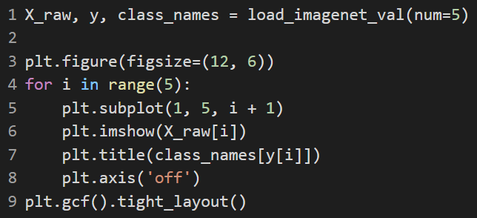
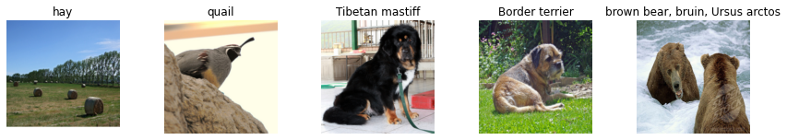
Visualize Feature Maps
Reading the images
Load some images from ImageNet validation set
X_raw: original images
y: labels
class_names: name of the class
Defining the transforms
Forward Propagation
Visualization
Notes:
Firstly, we will load some images from ImageNet validation set
In python code, the X_raw is the original images and y is the labels, class_names is the name of the class.
We will provide the imageNet validation set to you
Some example images are shown in the bottom.

Slide 12
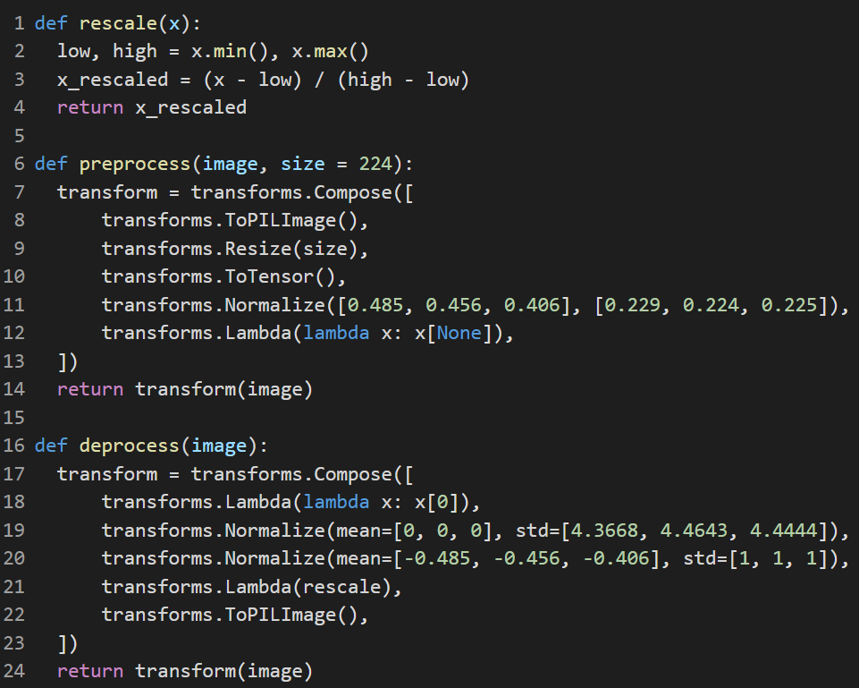
Visualize Feature Maps
Reading the images
Defining the transforms
Need the same preprocess as training the VGG-16 model
Forward Propagation
Visualization
Notes:
Next, we will have to define the necessary transforms as we train the VGG-16 model.
The standard preprocess includes resizing and normalizing the images
Otherwise, the feature maps will be incorrect.

Slide 13
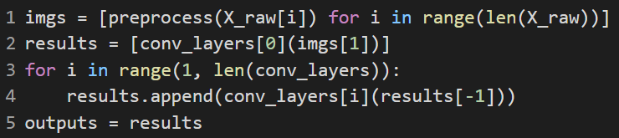
Visualize Feature Maps
Reading the images
Defining the transforms
Forward Propagation
The imgs[1] corresponds to quail image
Save feature maps of all Conv layers to a list
Visualization
Notes:
We then will apply forward propagation to the images and save the feature maps of all convolutional layers to a list.
In the python code, the imgs[1] refers to the quail image. You can also play with the code and try on other images.

Slide 14
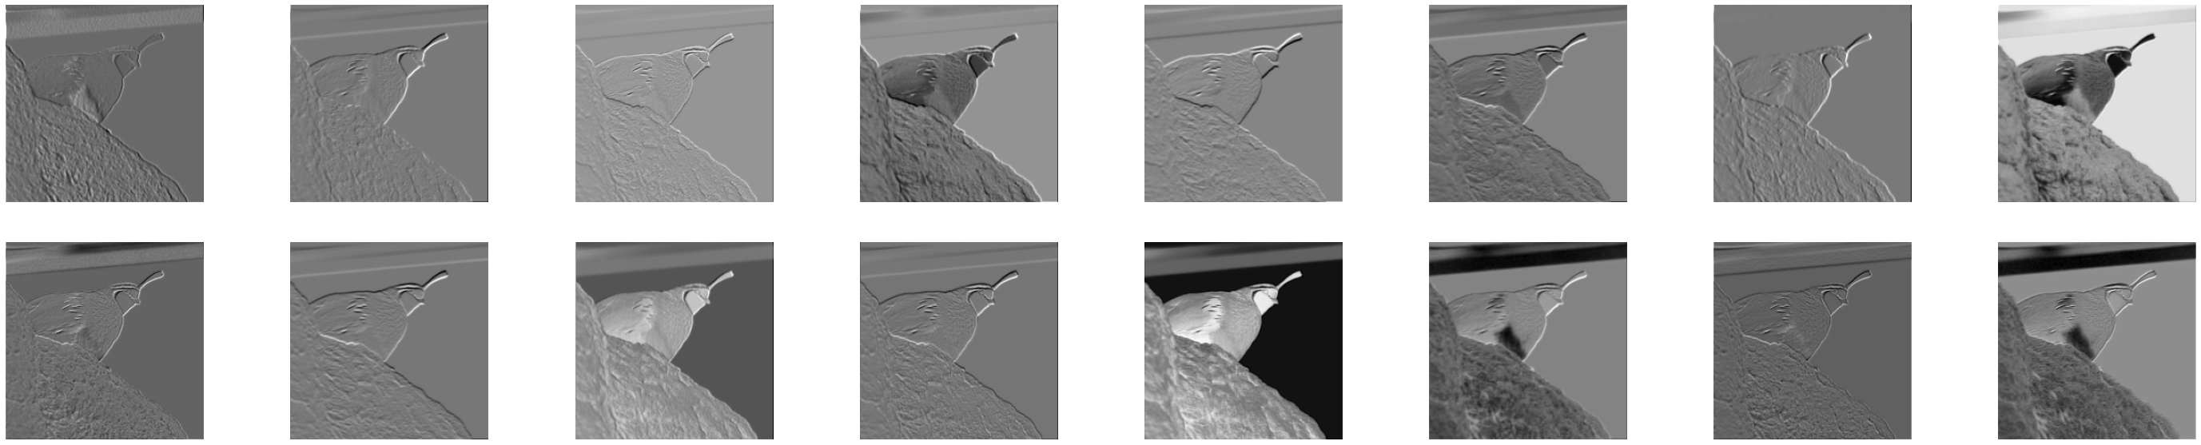
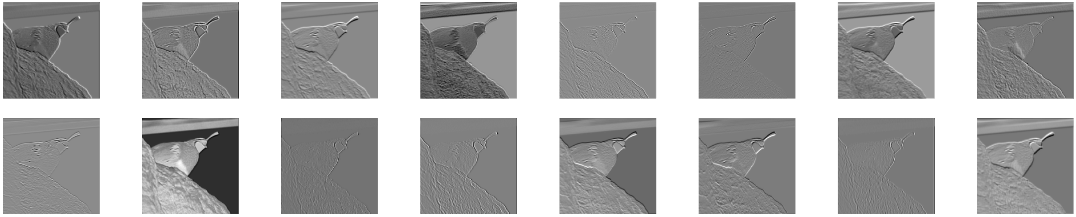
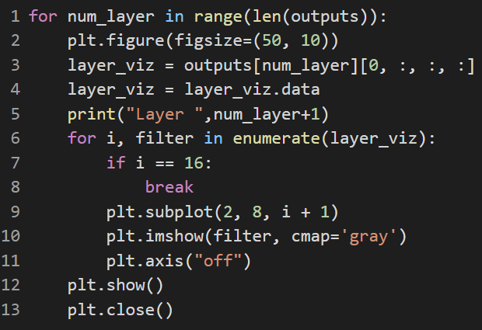
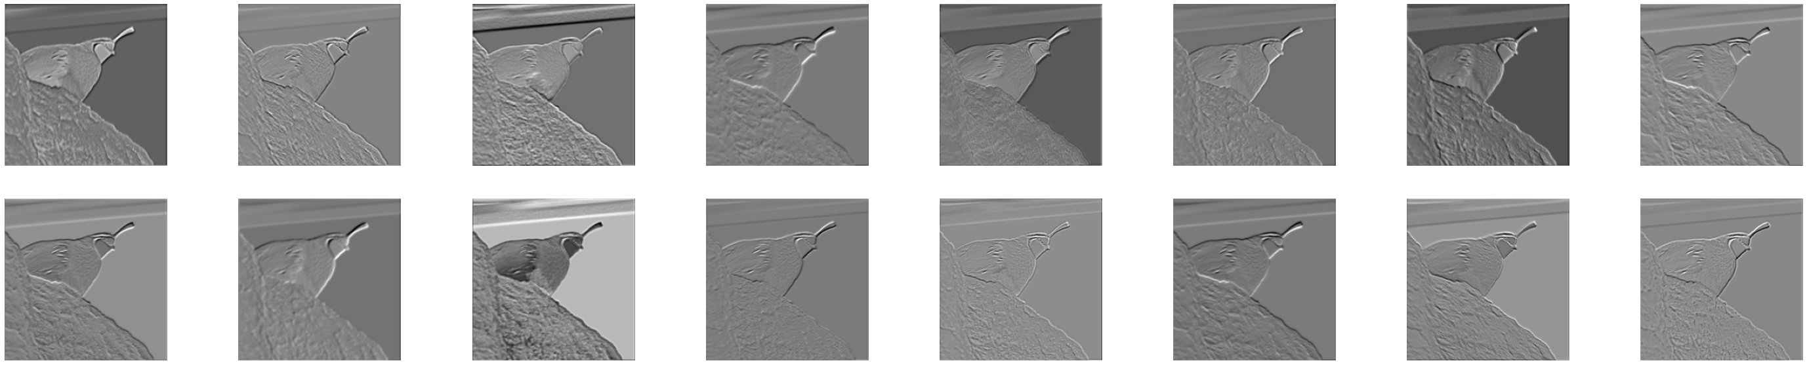
Visualize Feature Maps
Reading the images
Defining the transforms
Forward Propagation
Visualization
Layer 1 results
Layer 2 results
Layer 3 results
Notes:
Finally we can use a for loop to iterate the list and visualize the feature maps of every conv layers.
On the right, I show the results of first three conv layers of VGG-16. Due to the limit of space, I only plot 16 feature maps for each layer.
We can see some basic features such as the edges and corners are highlighted as we expect

Slide 15
CNN understanding
Notes:
Now we will introduce several methods to understand what exactly are learned in a CNN classification model

Slide 16
Example: Understanding the VGG-16 Model
Saliency Maps
Fooling Images
Class Visualization
Notes:
The first approach is called Saliency maps

Slide 17
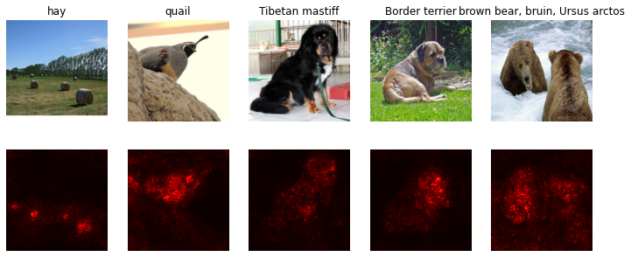
Saliency Maps
A saliency map tells us the degree to which each pixel in the image affects the classification score for that image.
To compute it, we compute the gradient of the unnormalized score corresponding to the correct class (which is a scalar) w.r.t the pixels of the image.
For each pixel in the image, this gradient tells us the amount by which the classification score will change if the pixel changes by a small amount.
Saliency Map Results
Notes:
A saliency map tells us the degree to which each pixel in the image affects the classification score for that image.
To compute it, we compute the gradient of the unnormalized score corresponding to the correct class with respect to the pixels of the images
For each pixel in the image, this gradient tells us the amount by which the classification score will change if the pixel changes by a small amount.
In the bottom, we show the saliency maps of the example figures. These highlighted red regions are the parts that really affect the classification score

Slide 18
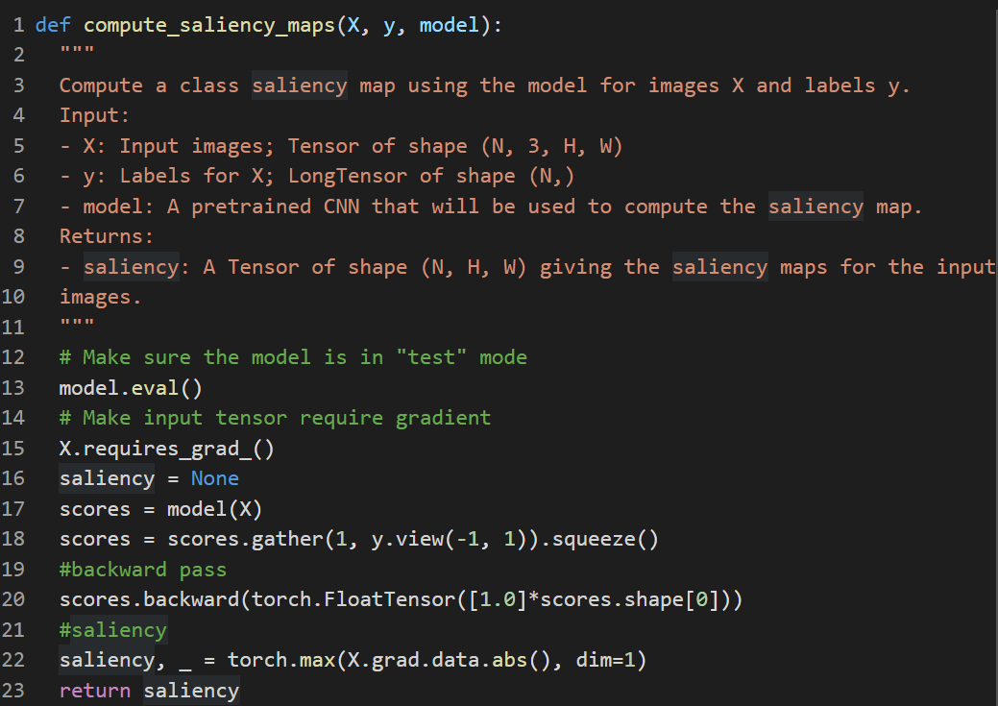
Saliency Maps
To compute the saliency map, we take the absolute value of the gradient, then take the maximum value over the 3 input channels
Notes:
In pytorch, we will do the forward propagation to obtain the scores
Then, to compute the saliency map, we will take the absolute value of the gradient and then take the maximum value over the 3 input channels

Slide 19
Example: Understanding VGG-16 Model
Saliency Maps
Fooling Images
Class Visualization
Notes:
In addition to saliency maps, we can also use the pre-trained network to generate some fooling images

Slide 20
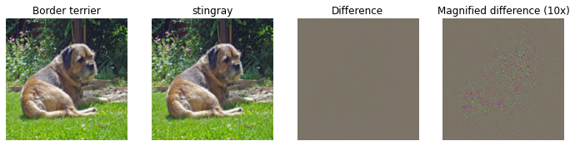
“Fooling” Images
We can also use image gradients to generate “fooling images” as discussed in the paper “Intriguing properties of neural networks” (ICLR 2014).
Given an image and a target class, we can perform gradient ascent over the image to maximize the target class, stopping when the network classifies the image as the target class.
After generating a fooling image, we can visualize the original, fooling image, as well as the difference between them.
You should ideally see at first glance no major difference between the original and the fooling image, but when looking at the 10x magnified difference between the original and the fooling image you should see a bit of random noise.
Fooling Image Result
Notes:
Given an image and a target class, we can perform gradient ascent over the image to maximize the target class, stopping when the network classifies the image as the target class
After generating a fooling image, we can visualize the original, fooling image, as well as the difference between them.
You should ideally see at first glance no major difference between the original and the fooling image, but when looking at the 10 times magnified difference between the original and the fooling image, you should see a bit of random noise.
In the bottom, we show that image of border terrier will be classified as stingray if we apply certain amount of noise to it

Slide 21
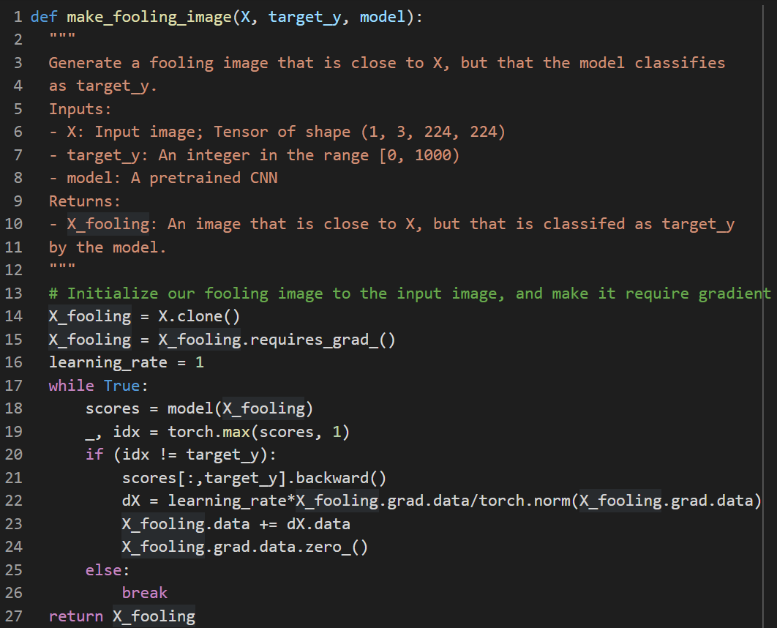
Creating a Fooling Image
We perform gradient ascent on the score of the target class, stopping when the model is fooled.
When computing an update step, first normalize the gradient
dX = learning_rate*g/||g||_2
For most examples, you should be able to generate a fooling image in fewer than 100 iterations of gradient ascent.
Notes:
In pytorch, we will first forward propagate the image and perform gradient ascent on the score of the target class
We will use a while loop and stop when the model is fooled
When computing an update step, we first normalize the gradient
For most examples, you should be able to generate a fooling image in fewer than 100 iterations of gradient ascent.

Slide 22
Example: Understanding VGG-16 Model
Saliency Maps
Fooling Images
Class Visualization
Notes:
Finally, we can also use a pre-trained network to generate a class visualization from random noise.

Slide 23




Class Visualization
By starting with a random noise image and performing gradient ascent on a target class, we can generate an image that the network will recognize as the target class.
Concretely, let be an image and let y be a target class. Let be the score that a convolutional network assigns to the image for class y; note that these are raw unnormalized scores, not class probabilities. We wish to generate an image that achieves a high score for the class y by solving the problem
Where R is a (possibly implicit) regularizer. We can solve this optimization problem using gradient ascent, computing gradients with respect to the generated image. We will use (explicit) L2 regularization of the form
We can solve this problem using gradient ascent on the generated image.
Notes:
By starting with a random noise image and performing gradient ascent on a target class, we can generate an image that the network will recognize as the target class.
By solving the problem as described here
Of the form shown below

Slide 24
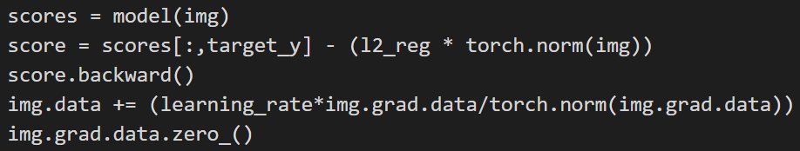
Class Visualization
Random initialize an image
Within a for loop, solve the optimization problem
Notes:
In pytorch, the two main steps are
First we will randomly initiliaze an image
Then within a for loop, we will solve the optimization problem using gradient ascent as we described before
The full code is provided to you, and we strongly recommend you fully understanding every step

Slide 25
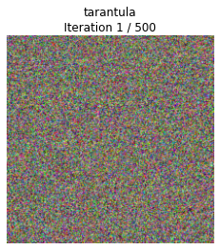
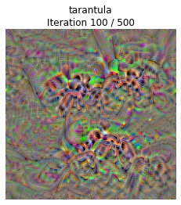
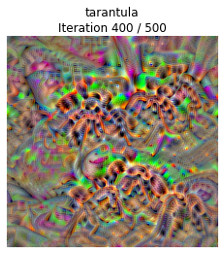

Class Visualization
The figures on the right show the class visualization progress on the tarantula class. Try out your class visualization on other classes!
You should also feel free to play with various hyperparameters to try and improve the quality of the generated image.
Notes:
Finally, The figures on the right show the class visualization progress on the tarantula class. Try out your class visualization on other classes!
You should also feel free to play with various hyperparameters to try and improve the quality of the generated image.
That’s it for today’s practical lecture, thank you!

